Slide 1
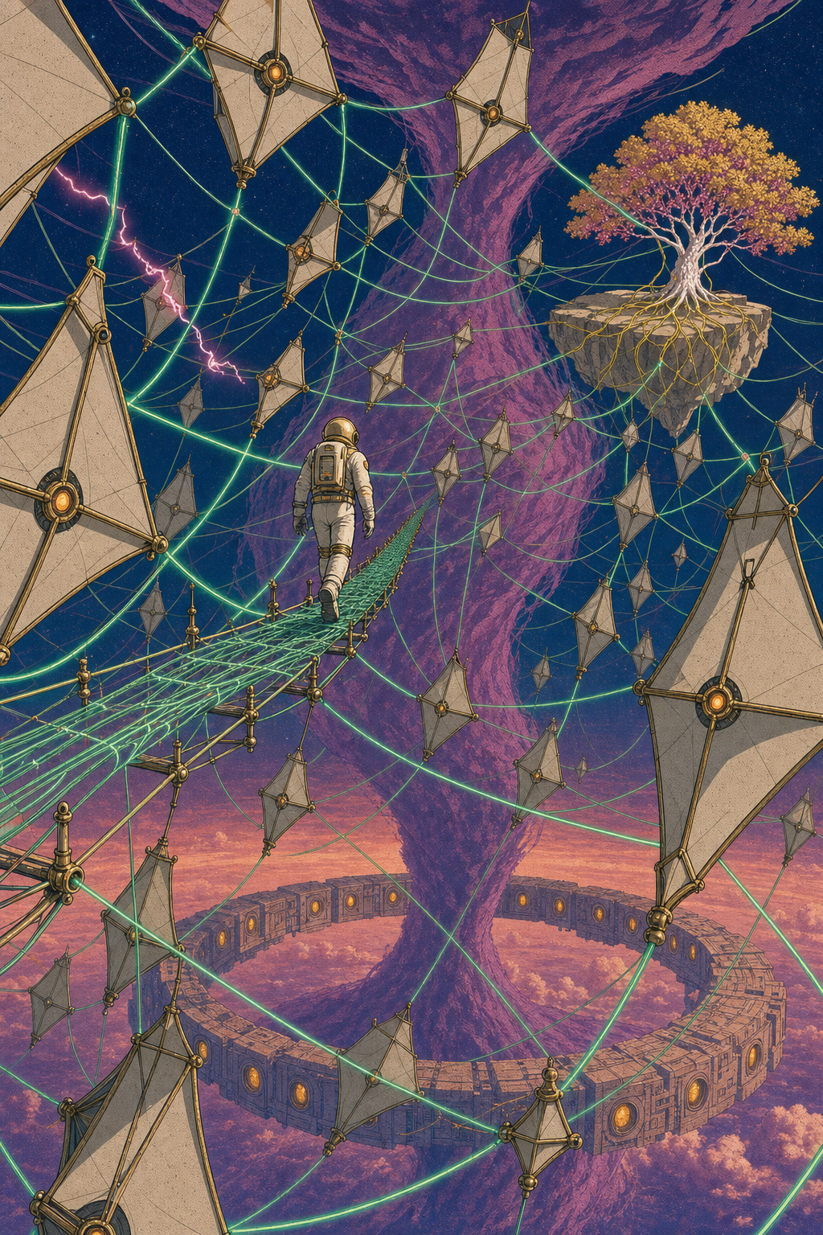
AI Engineer Agentic Track
The Complete
Agent & MCP
Course
Week 5
Day 3

Slide 2
Week 6: MCP
Agentic
Architecture
and MCP
Building an
MCP Server
and Client
Multiple Local
and Remote
MCP servers
Project 8: AI
Equity Traders
Project 8: AI
Equity Traders
In Action
Week 5: Agent Frameworks
Google ADK and A2A
Strands and Pydantic AI
MAF and
Agno
Mastra
Project 7:
Agent
Loop
Week 4: LangGraph
LangChain Core
LangGraph
LangChain
create_agent
Deep Agents
Project 6:
Sidekick
Week 3: CrewAI
Understand
Crew AI
Concepts
Build a Crew
Agent
Project 4: Stock
Picker
Project 5:
Developer
Agent
Project 5:
Engineering
Team
Week 2: OpenAI Agents SDK
Understand
OpenAI Agents
SDK concepts
Project 2: an
SDR
Tools vs Agents
Guardrails
Project 3: Deep
Research
Project 3: Deep
Research app
Week 1: Foundations
Make an
Agentic
Workflow
Agents and
Agentic
Patterns
Orchestrating
LLMs
Autonomy and
Tools
Project 1:
Your personal
career agent

Slide 3
Introducing MAF
The Microsoft Agent Framework
What it is Microsoft's official open-source agent SDK
The convergence AutoGen orchestration meets Semantic Kernel discipline
How we use it Python with gpt-5.4-mini via OpenAIChatClient
Maturity GA since April 2026, agent-framework-core 1.8.1

Slide 4




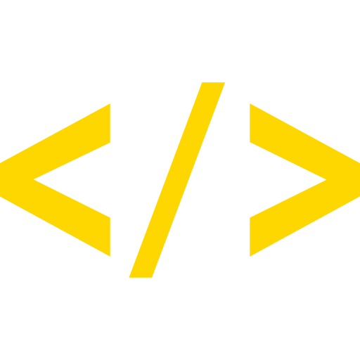
MAF: key features
What stands out
Tools plain typed Python functions, no decorator needed
MCP MCPStdioTool runs a server, passed via tools=
Agent loop await agent.run() drives the full tool-calling loop
Workflows durable graph engine with checkpointing and human approval
.NET offering the same Agent shape in Python and .NET

Slide 5
MAF: the trade-offs
Strengths and downsides
Durable workflows checkpointing and human-in-the-loop out of the box
Two languages one agent API mirrored across Python and .NET
Observability built-in OpenTelemetry plus the DevUI inspector
Rename churn the 2026 renames make most old snippets wrong
Two of everything rival construction styles and client classes in the docs

Slide 6
Introducing Agno
Fast Open-Source framework paired with AgentOS
What it is a fast, lightweight Python agent framework, formerly Phidata
Standout roughly 3 microseconds to instantiate an agent
How we use it OpenAIChat(id="gpt-5.4-mini") in a bare Agent
Maturity GA, v2.6.14, the AgentOS rewrite shipped Sept 2025

Slide 7


Agno: key features
What stands out
Tools a typed function with a docstring, zero ceremony
MCP MCPTools dropped into the same tools= list
Agent loop await agent.arun() runs the full loop, returns .content
Blazing startup about 6.6 KiB per agent, benchmarked against the field
AgentOS companion product to deploy, run and scale: a few lines turn agents into a FastAPI runtime

Slide 8
Agno: the trade-offs
Strengths and downsides
Tiny tools lowest-ceremony tool definition of the whole group
Fast and lean fastest instantiation, with published benchmarks
Real runtime AgentOS and first-class A2A in the same package
Rename churn the v1 to v2 rewrite leaves old snippets wrong
Platform pull towards AgentOS

Slide 9
Week 6: MCP
Agentic
Architecture
and MCP
Building an
MCP Server
and Client
Multiple Local
and Remote
MCP servers
Project 8: AI
Equity Traders
Project 8: AI
Equity Traders
In Action
Week 5: Agent Frameworks
Google ADK and A2A
Strands and Pydantic AI
MAF and
Agno
Mastra
Project 7:
Agent
Loop
Week 4: LangGraph
LangChain Core
LangGraph
LangChain
create_agent
Deep Agents
Project 6:
Sidekick
Week 3: CrewAI
Understand
Crew AI
Concepts
Build a Crew
Agent
Project 4: Stock
Picker
Project 5:
Developer
Agent
Project 5:
Engineering
Team
Week 2: OpenAI Agents SDK
Understand
OpenAI Agents
SDK concepts
Project 2: an
SDR
Tools vs Agents
Guardrails
Project 3: Deep
Research
Project 3: Deep
Research app
Week 1: Foundations
Make an
Agentic
Workflow
Agents and
Agentic
Patterns
Orchestrating
LLMs
Autonomy and
Tools
Project 1:
Your personal
career agent

Slide 10

AI Engineer Agentic Track
The Complete
Agent & MCP
Course
77%
Complete

